Slide 1





The Sheep Detectives
Presents
SentinelX
Integrated Crime, Digital Safety & Consumer Rights Protection System
TEAM MEMBERS:
Md. Maharab Hossain Opu
ID: 0112330123
Fahim Bin Kibria
ID: 0112330649
Ishra Tabassum
ID: 0112330124
Raihan Ahmed Shuvo
ID: 0112330457

Slide 2

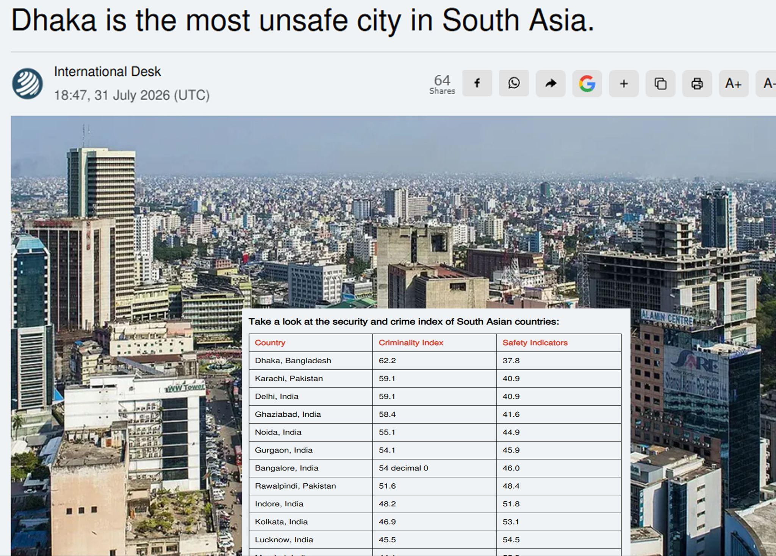

The Idea
SentinelX is a unified digital platform that modernizes crime reporting, consumer rights protection, and public safety services in Bangladesh. It combines AI-powered analytics, anonymous reporting, offline SMS support, and real-time case tracking to improve transparency, accessibility, and trust between citizens and authorities.
The Problem
No unified digital crime reporting platform
Manual reporting is slow and inconvenient
Fear of identity exposure
Limited transparency in case progress
Low public trust in reporting systems
Consumer complaints are mostly manual
Authorities lack centralized real-time data

Slide 3
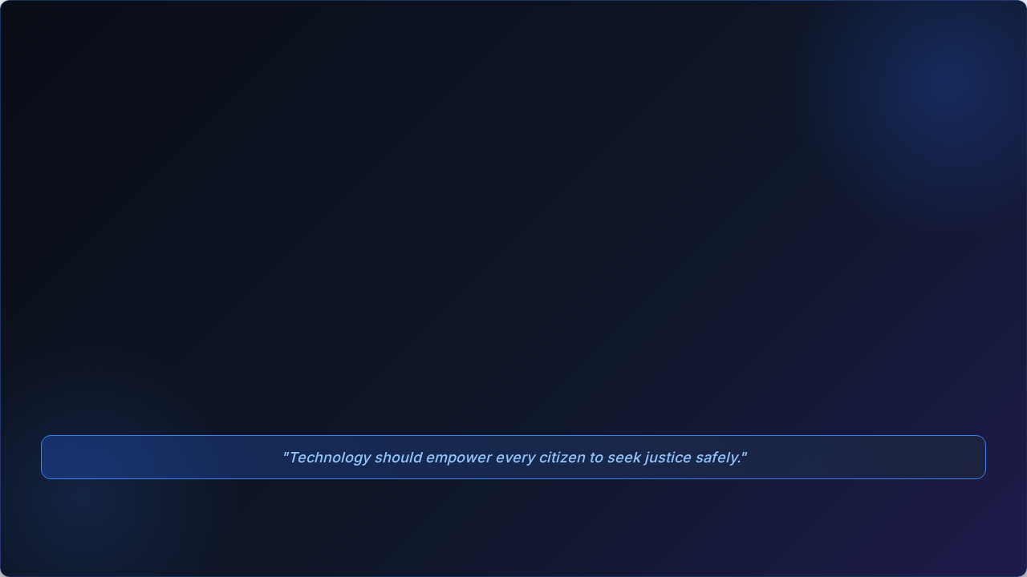


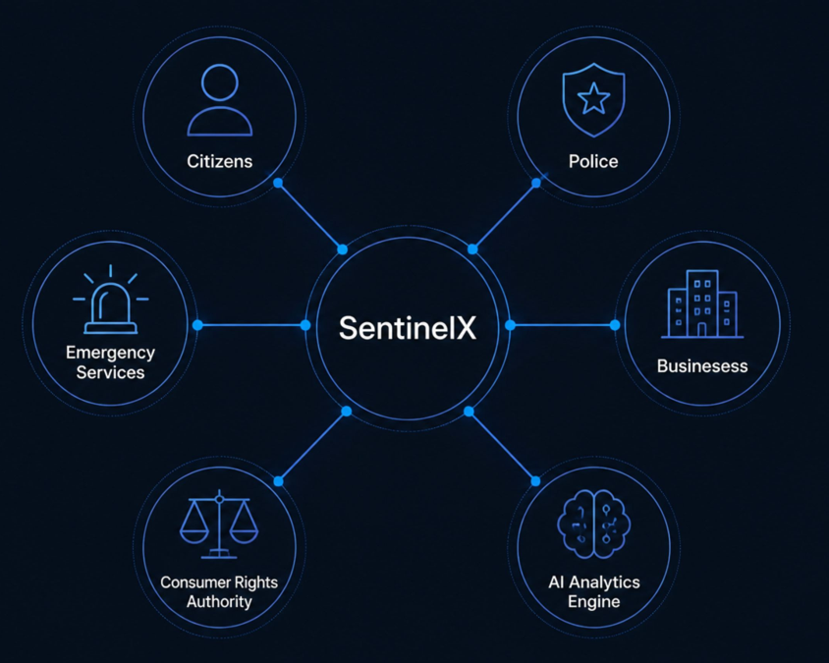
MOTIVATION :
To simplify public safety by bringing all essential services into one intelligent platform.
Our motivtion is to use technology and AI to make public safety services more accessible, transparent, and trustworthy for every citizen

Slide 4
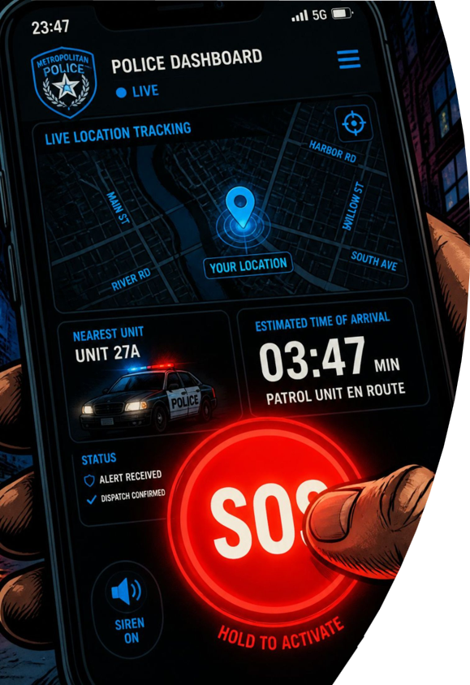
Solution
AI-powered unified platform that enables citizens to report incidents, request emergency assistance, receive community alerts, protect consumer rights.
All from a single secure application.

Slide 5

Tech Stack
Frontend
( Flutter )
Single codebase for iOS & Android, high native performance.
Backend
( Flask REST API [Python] )
Flutter App
Flask Backend
AI Engine
YOLO
Whisper
EasyOCR
Scikit-learn
and
map & notification
Android & iOS App
Citizen Interface
Lightweight Python microservice with seamless Al library binding.
REST API & Business Logic
( MySQL )
Database
ACID-compliant relational engine for structured safety records.
( Python, YOLO, Whisper, EasyOCR, Scikit-learn )
AI / ML
REST API
MySQL
HTTP endpoints and routing
Structured Data Storage
Image detection, speech transcription,OCR
fraud detection and predictive analytics
( Firebase + JWT )
Cloud & Auth
Instant emergency alerts and push notifications, secure user authentication and session management
QA Testing: (Selenium)
Automated Testing

Slide 6

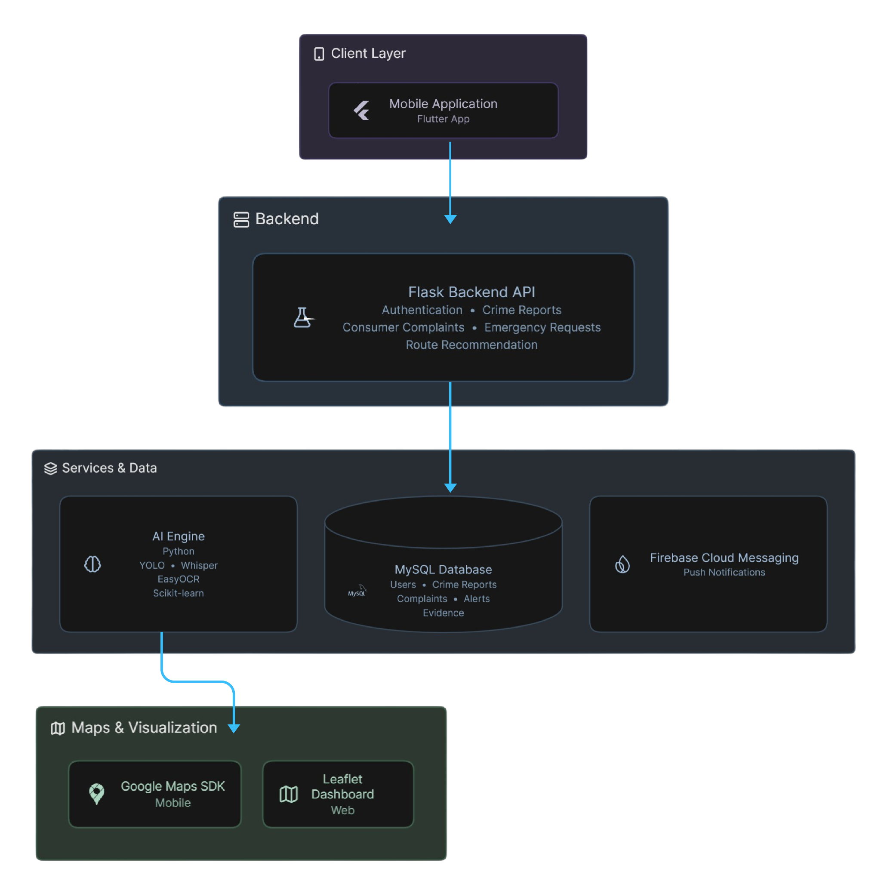

System Architecture

Slide 7




Core Features
1. Smart Crime Report
2. Crime Heatmap
3. Community Alert
•
Anonymous or named submission options
•
Color-coded risk zones (Green to Red)
•
Crowdsourced public safety updates
•
Supports photo, video, voice & GPS tags
•
Filter by district, time & crime type
•
AI fake-alert detection mechanism
4. Shop Trust
5. Offline Report SMS Mode
6. AI Intelligence
•
Barcode scan & price verification
•
Emergency reporting without internet
•
Crime hotspot prediction algorithms
•
25% legal reward on verified complaints
•
Sends GPS & auto-syncs when online
•
Automated priority assignment & OCR
7. Emergency SOS
8. Consumer Rights Report
•
Immediately sends live location , Emergency contacts
• Submit complaints against fake products, overpricing, and expired goods.
• Verified complaints support legal action and eligible citizen rewards.
•
Automatically records microphone audio after SOS.

Slide 8




Collaboration & Challenges
Team Collaboration
Ishra Tabassum
Key Challenges & Solutions
Our main challenge was building a secure, transparent, and accessible reporting platform. To overcome this, we introduced anonymous crime reporting, offline SMS support, AI-assisted report verification, real-time progress tracking, and encrypted digital evidence storage, creating a more reliable and citizen-friendly system.
Md. Maharab Hossain Opu
Fahim Bin Kibria
Tools used
Raihan Ahmed Shuvo

Slide 9
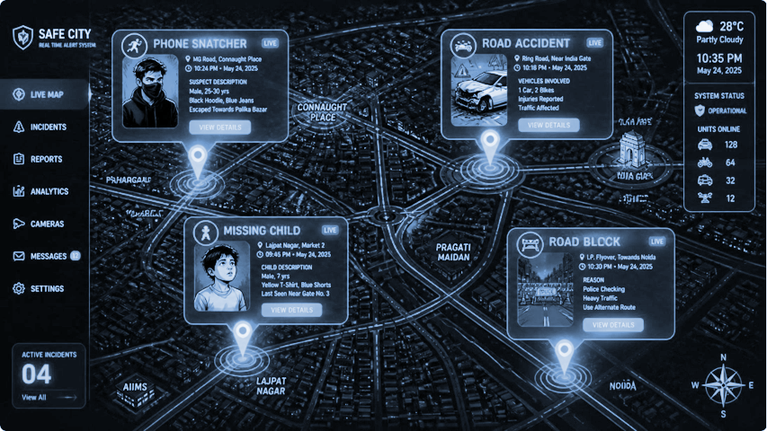

Future Scope & Impact
Government & Industry Integration
Bangladesh Police Digital System
National Emergency Service (999)
DNCRP (Consumer Rights Authority)
BTRC (Bangladesh Telecommunication Regulatory Commission)
Telecom Operators (Grameenphone, Robi, Banglalink, Teletalk)
NID Verification System (Authorized Access)
Expected Impact
Faster Emergency Response
Enhanced Transparency
High Public Trust
Consumer Rights Action

Slide 10

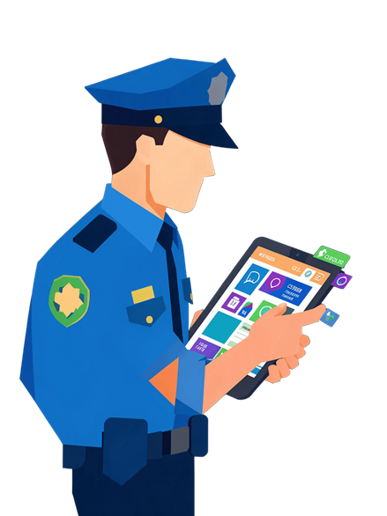

THANK YOU

